Slide 1
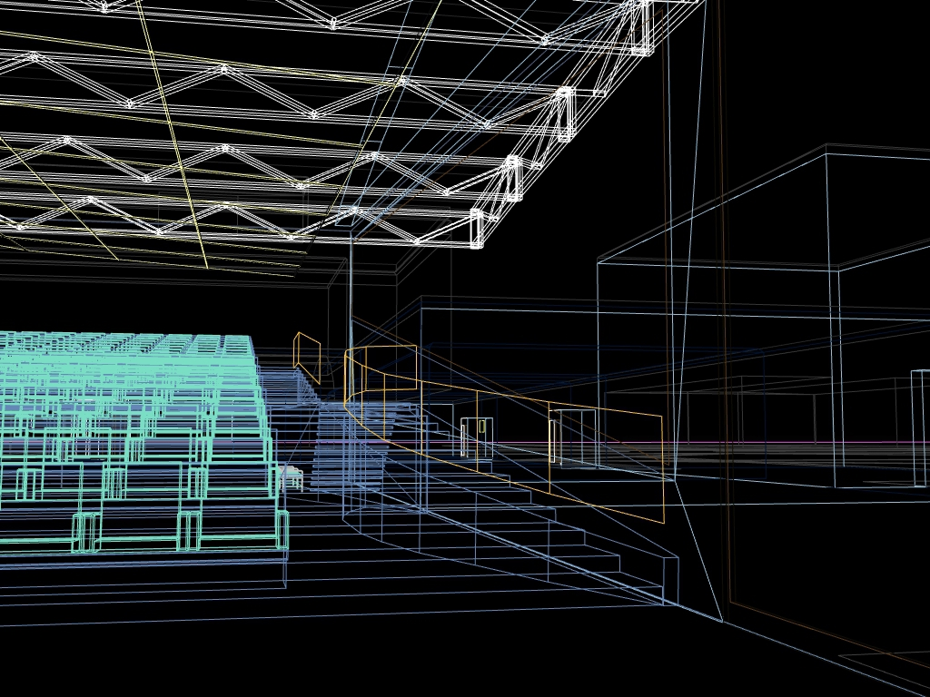
VECTORS WITH VIDEO GAMES
Will Monroe
Splash! Teaching Program
April 11-12, 2015
Image credit: Wikimedia Commons user Manop

Slide 2
Video: Portal clip

Slide 3

Image credit: DGBthekafu / Wikimedia Commons user Bouncey2k

Slide 4
y
x
Image credit: DGBthekafu / Wikimedia Commons user Bouncey2k

Slide 5
y
(x, y)
x
Image credit: DGBthekafu / Wikimedia Commons user Bouncey2k

Slide 6
x
(x, y)
y
Image credit: DGBthekafu / Wikimedia Commons user Bouncey2k

Slide 7
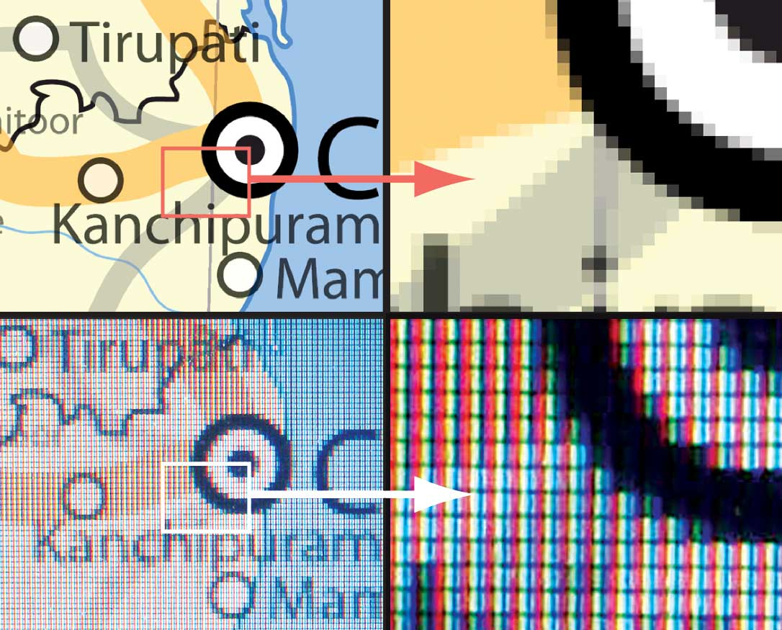
Pixels
Image credit: Wikimedia Commons user Planemad

Slide 8
x
z
(x, y, z)
y
Image credit: DGBthekafu / Wikimedia Commons user Bouncey2k

Slide 9
Demo: Orthographic projection

Slide 10
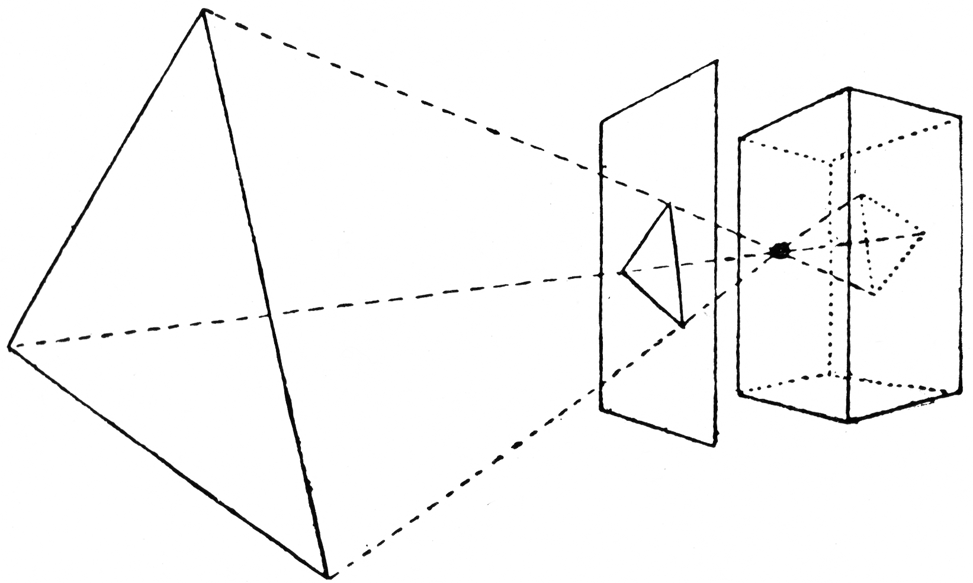
The pinhole camera
(the original graphics hardware)
Image credit: L.P. Clerc/Wikimedia Commons user Atelierelealbe

Slide 11
The pinhole camera
(the original graphics hardware)
1
5
1
5
Image credit: L.P. Clerc/Wikimedia Commons user Atelierelealbe

Slide 12
The pinhole camera
(the original graphics hardware)
H
C
P
D
H P
D C
__ __
=
Image credit: L.P. Clerc/Wikimedia Commons user Atelierelealbe

Slide 13
The pinhole camera
(the original graphics hardware)
H
C
P
D
P H
C D
HC
D
__ __
___
=
P =
Image credit: L.P. Clerc/Wikimedia Commons user Atelierelealbe

Slide 14

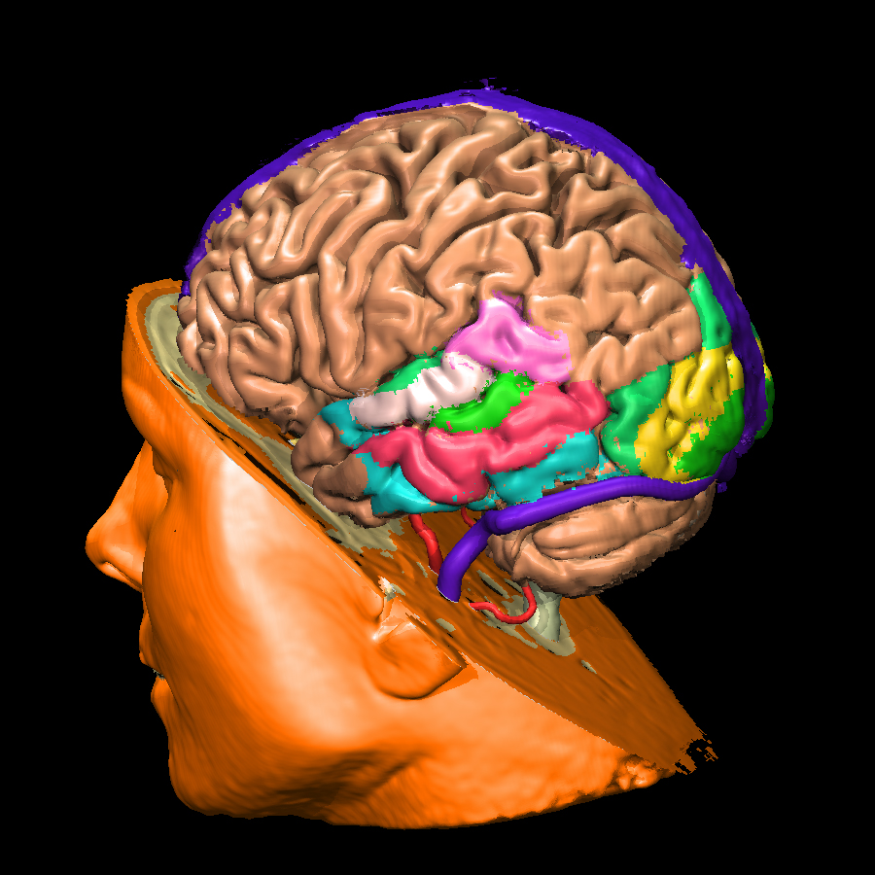
Voxels?
Voxel-based
brain imaging
Minecraft
How many voxels
do we need?
Image credits: Mojang AB/Wikimedia Commons users 4urge, Muehlenau

Slide 15
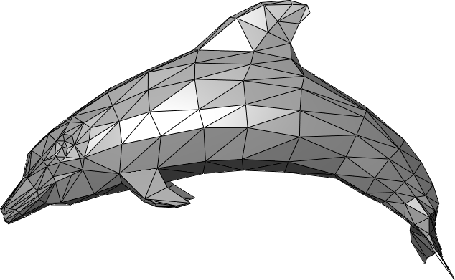
Triangles!
Image credit: Wikimedia Commons user Chrschn

Slide 16
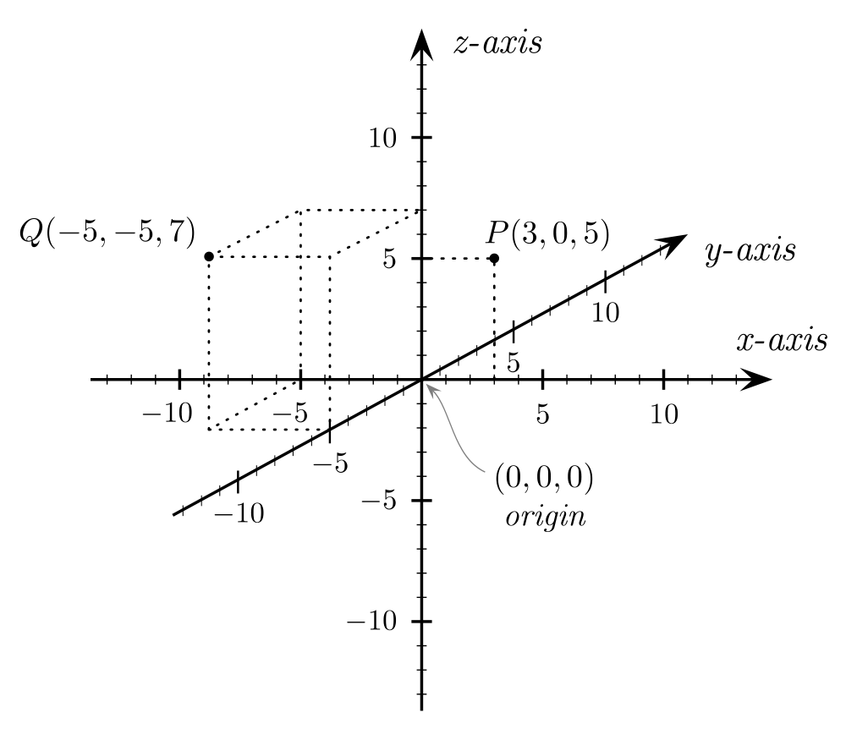
3-D Cartesian coordinates
Image credit: Wikimedia Commons user Gustavb

Slide 17
Demo: Journeys of a Teapot

Slide 18
Vector addition
a = ( 5, 6, -3)
b = (-1, 7, 2)
a + b = (5 + (-1), 6 + 7, (-3) + 2)
= (4, 13, -1)

Slide 19
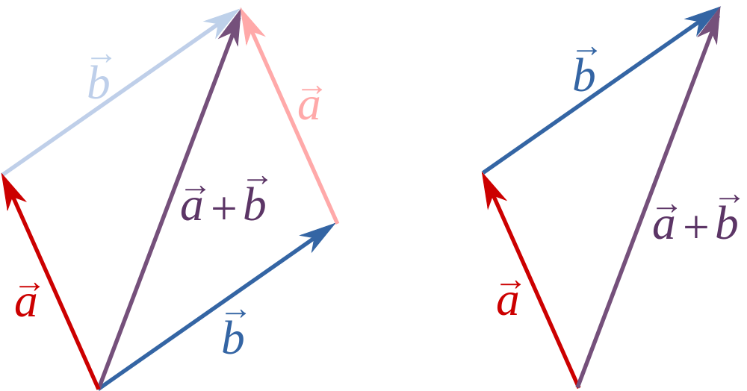
Vector addition
Image credit: Wikimedia Commons user 石庭豐

Slide 20
Points → vectors from the origin
Q
P
Image credit: Wikimedia Commons user Gustavb

Slide 21

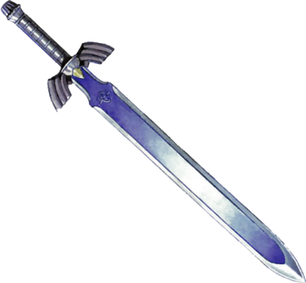
Relative positioning of objects
O
Image credits: kasuto.net, zelda.wikia.com

Slide 22
Demo: Placing the camera

Slide 23
Vector subtraction
a = ( 5, 6, -3)
b = (-1, 7, 2)
a – b = (5 – (-1), 6 – 7, (-3) – 2)
= (6, -1, -5)

Slide 24
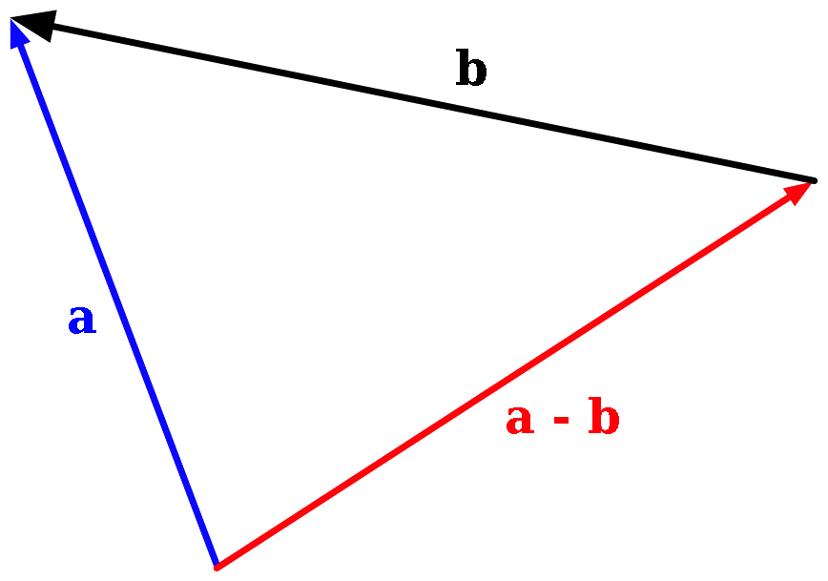
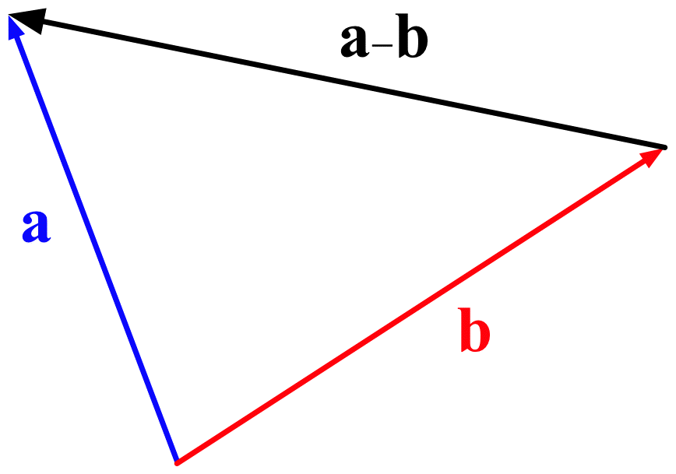
Vector subtraction
Image credit: Wikimedia Commons user bdesham

Slide 25
Scalar multiplication
a = ( 5, 6, -3)
5a = (5·5, 5·6, 5·(-3))
= (25, 30, -15)

Slide 26
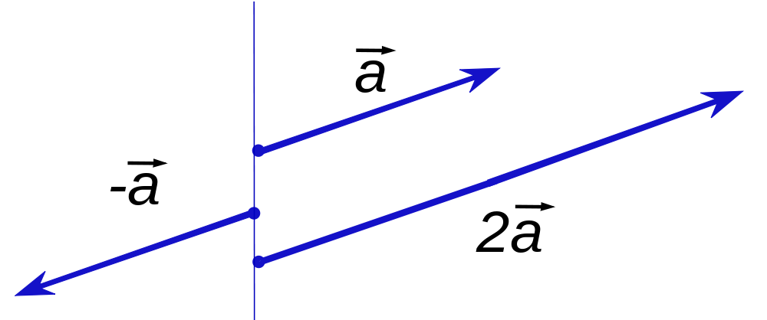
Scalar multiplication
Image credit: Silly rabbit/Wikimedia Commons user Konradek

Slide 27
Demo: Placing the camera

Slide 28
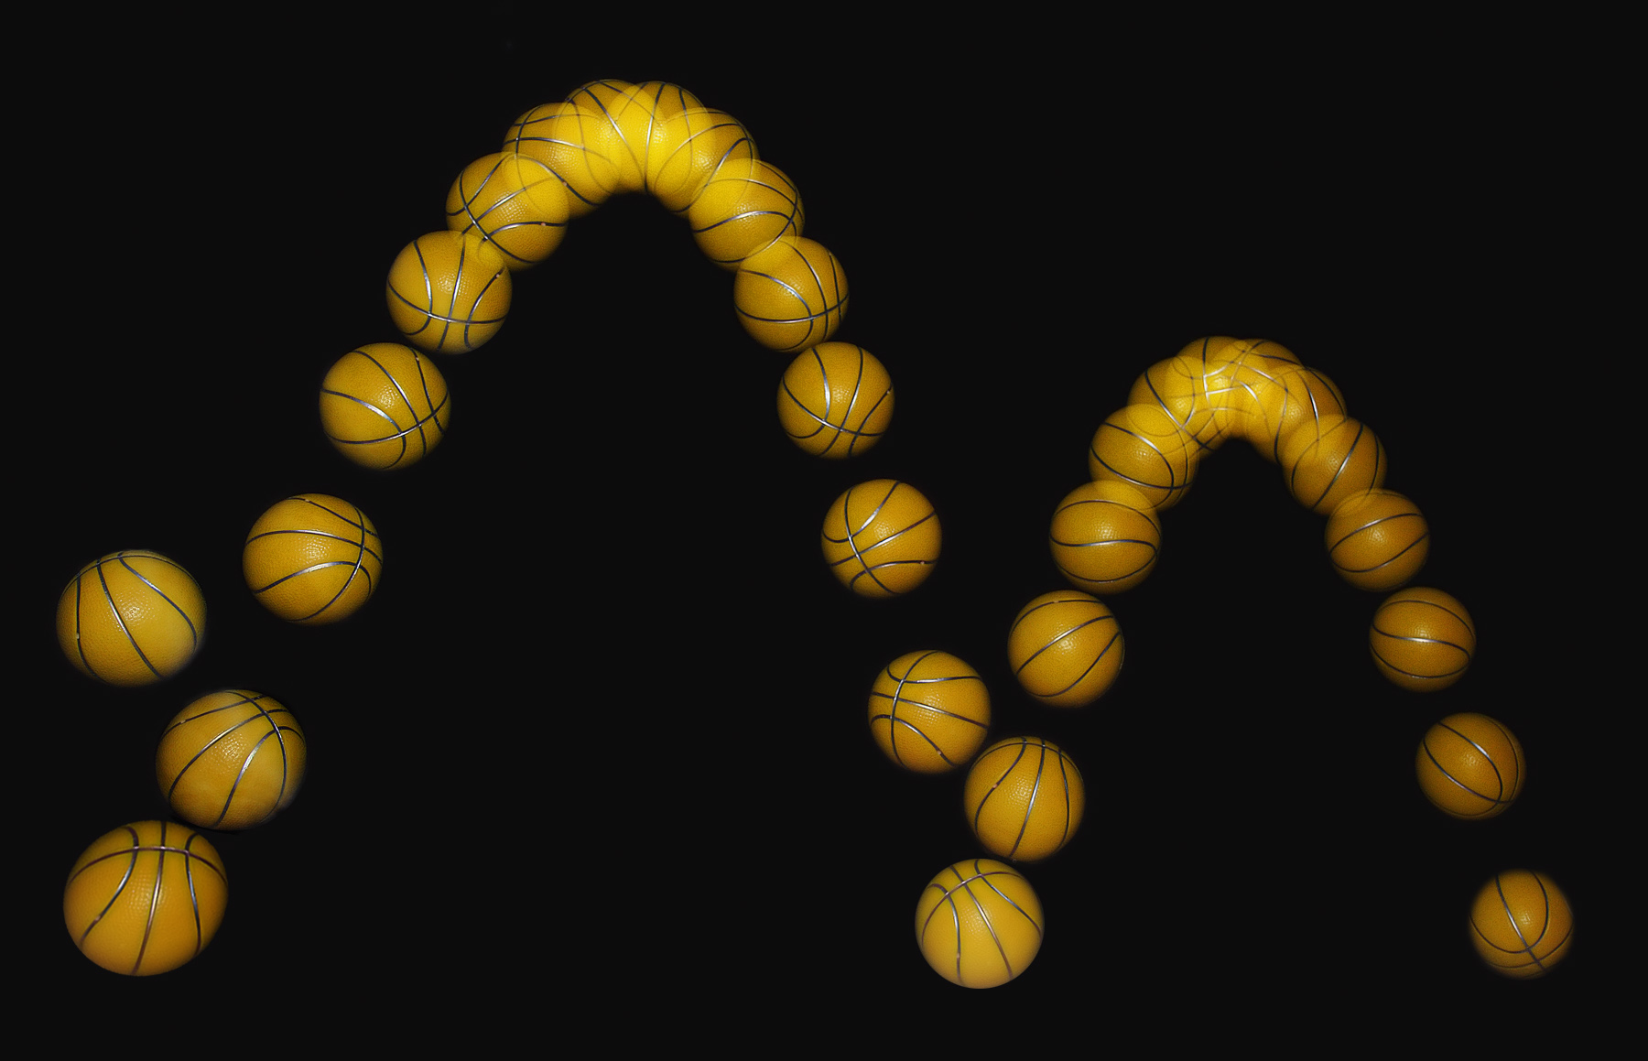
Moving objects
Image credit: Michael Maggs/Richard Bartz

Slide 29
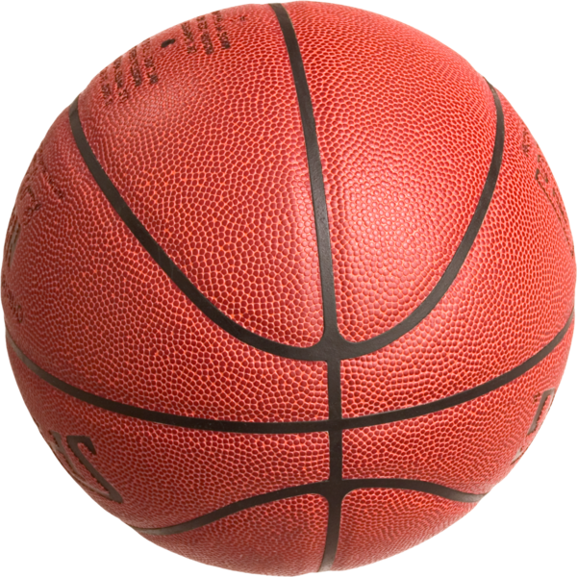
Applying speed in small steps
(This is called “Euler's method for numerical integration.”
No, you don't have to remember that. But you can if you want.)
v = 5 m/s
Image credit: Wikimedia Commons user MrX

Slide 30
Applying speed in small steps
(This is called “Euler's method for numerical integration.”
No, you don't have to remember that. But you can if you want.)
v = 5 m/s
t = 1/60 s
Image credit: Wikimedia Commons user MrX

Slide 31
Applying speed in small steps
(This is called “Euler's method for numerical integration.”
No, you don't have to remember that. But you can if you want.)
v = 5 m/s
t = 1/60 s
d = v · t = 1/12 m
Image credit: Wikimedia Commons user MrX

Slide 32
Applying speed in small steps
(This is called “Euler's method for numerical integration.”
No, you don't have to remember that. But you can if you want.)
v = 5 m/s
t = 1/60 s
d = v · t = 1/12 m
Image credit: Wikimedia Commons user MrX

Slide 33
Applying speed in small steps
(This is called “Euler's method for numerical integration.”
No, you don't have to remember that. But you can if you want.)
v = 5 m/s
t = 1/60 s
d = v · t = 1/12 m
Image credit: Wikimedia Commons user MrX

Slide 34
Applying speed in small steps
(This is called “Euler's method for numerical integration.”
No, you don't have to remember that. But you can if you want.)
v = 5 m/s
t = 1/60 s
d = v · t = 1/12 m
Image credit: Wikimedia Commons user MrX

Slide 35
Applying speed in small steps
(This is called “Euler's method for numerical integration.”
No, you don't have to remember that. But you can if you want.)
v = 5 m/s
t = 1/60 s
d = v · t = 1/12 m
Image credit: Wikimedia Commons user MrX

Slide 36
Applying speed in small steps
(This is called “Euler's method for numerical integration.”
No, you don't have to remember that. But you can if you want.)
v = 5 m/s
t = 1/60 s
d = v · t = 1/12 m
Image credit: Wikimedia Commons user MrX

Slide 37
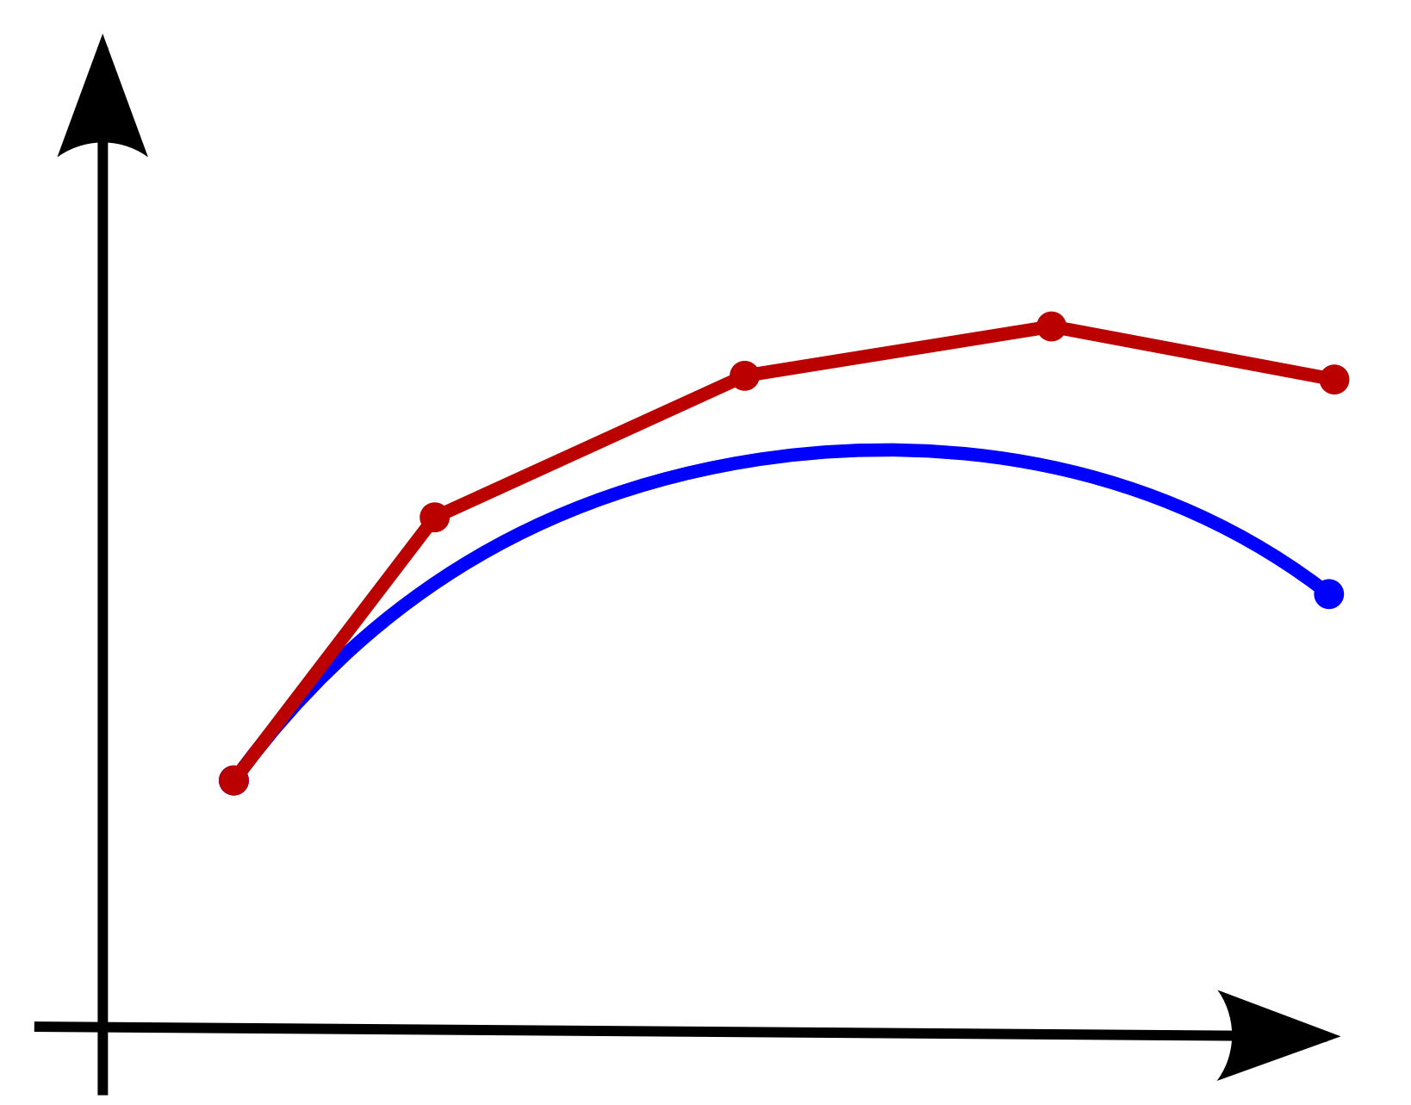
Applying speed in small steps
(This is called “Euler's method for numerical integration.”
No, you don't have to remember that. But you can if you want.)
v = 5 m/s
t = 1/60 s
d = v · t = 1/12 m
Image credit: Wikimedia Commons user MrX

Slide 38
Demo: Moving the teapot

Slide 39
The dot product
a = ( 5, 6, -3)
b = (-1, 7, 2)
a · b = 5·(-1) + 6·7 + (-3)·2
= -5 + 42 + -6 = 31

Slide 40
An illustrative example
 | Heller (R) | Reid (D)
37 | Y | Y
38 | Y | N
39 | N | Y
40 | N | N
41 | N | Y
42 | Y | N
43 | Y | N
45 | N | N
46 | Y | Y
54 | N | Y
Source: http://govtrack.us/

Slide 41
An illustrative example
 | Heller (R) | Reid (D) | product
37 | +1 | +1 | +1
38 | +1 | -1 | -1
39 | -1 | +1 | -1
40 | -1 | -1 | +1
41 | -1 | +1 | -1
42 | +1 | -1 | -1
43 | +1 | -1 | -1
45 | -1 | -1 | +1
46 | +1 | +1 | +1
54 | -1 | +1 | -1
Total:
-2
Source: http://govtrack.us/

Slide 42
An illustrative example
 | Boxer (D) | Feinstein (D)
37 | N | N
38 | N | N
39 | Y | Y
40 | N | N
41 | Y | Y
42 | N | N
43 | N | N
45 | N | N
46 | Y | Y
54 | Y | Y
Source: http://govtrack.us/

Slide 43
An illustrative example
 | Boxer (D) | Feinstein (D) | product
37 | -1 | -1 | +1
38 | -1 | -1 | +1
39 | +1 | +1 | +1
40 | -1 | -1 | +1
41 | +1 | +1 | +1
42 | -1 | -1 | +1
43 | -1 | -1 | +1
45 | -1 | -1 | +1
46 | +1 | +1 | +1
54 | +1 | +1 | +1
Total:
+10 (!)
Source: http://govtrack.us/

Slide 44
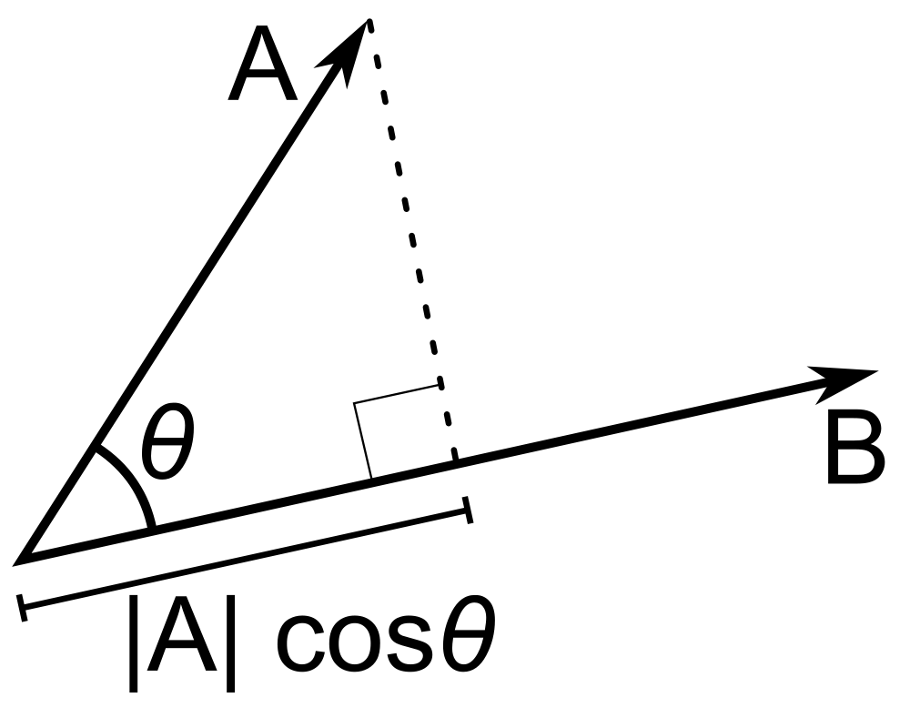
Projecting one vector onto another
The real dot product:
|A| |B| cos θ
Image credit: Wikimedia Commons user Mazin07

Slide 45

Lighting matters
Image credit: Wikimedia Commons user Pokipsy76

Slide 46
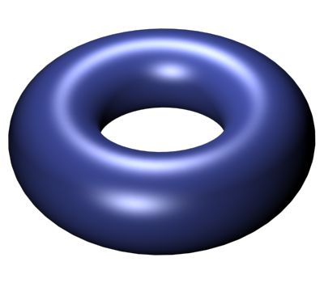
Lighting matters
Image credit: Wikimedia Commons user Pokipsy76

Slide 47
Video: Phong shading

Slide 48
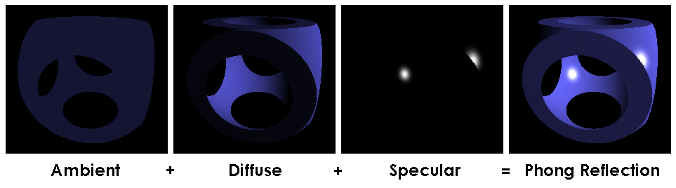
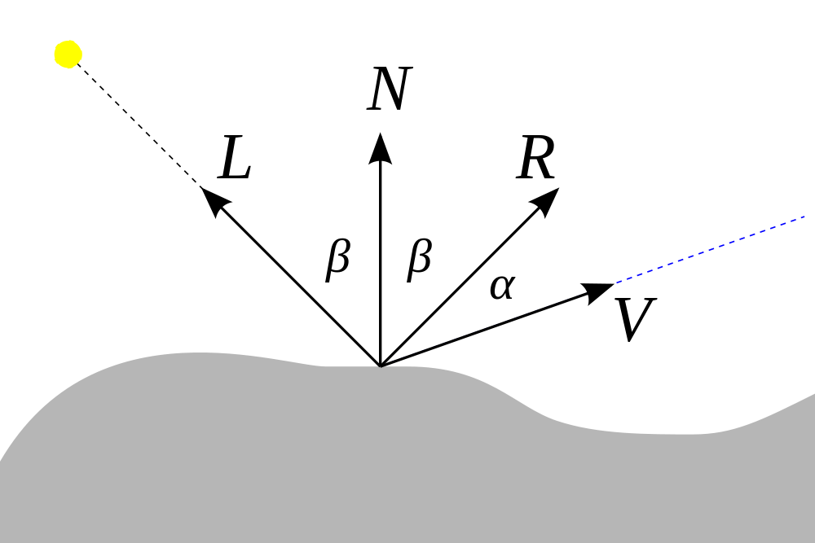
Lighting
The Phong illumination model
Ambient: constant
Diffuse: L · N = cos β
Specular: (R · V)^{k} = (cos α)^{k}
Image credit: Brad Smith/Wikimedia commons user Rainwarrior

Slide 49
Demo: Turning on the sun

Slide 50
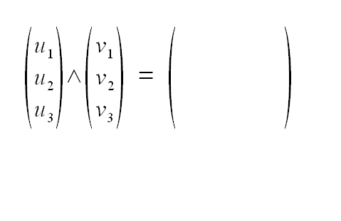
The cross product
Image credit: Wikimedia Commons user Ravahimanana

Slide 51
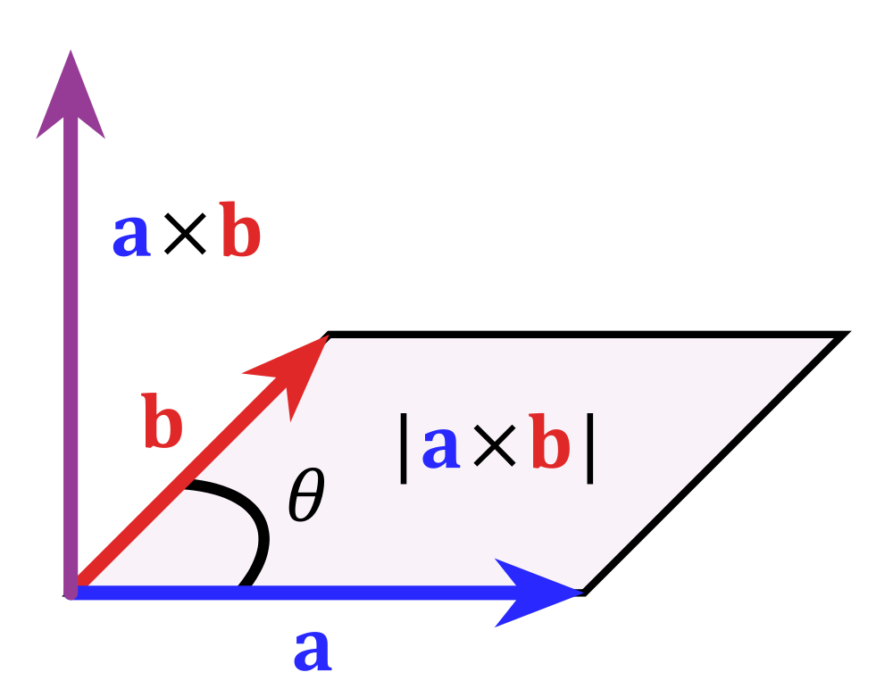
The cross product
Image credit: Wikimedia Commons user Acdx

Slide 52
Thank you!
Code and slides:
http://stanford.edu/~wmonroe4/splash
(wait a day or two)

